Slide 1
HOW TO REDUCE HOUSEHOLD CARBON FOOTPRINT
Raj Jangra, Hannah Mayhew, Emma Elley, Immanuella Busari
UseLess
Prototype here: https://pr.to/R1O84Y/

Slide 2
WHY SHOULD WE CARE?
01
02
03
CLIMATE CHANGE
PUBLIC HEALTH
GLOBAL ECONOMY
04
05
SPECIES DIVERSITY
PERSONAL EXPENDITURE
Reduce global warming, sea-level rise, ice melting, ocean acidification
Improves air/water quality, healthy food supply, biodiversity
Economically rewarding to innovate solutions for climate change
Reduces effects of climate change and reduces adaptation pressure
Reduction in the cost of living by making smarter environmental choices

Slide 3

Introducing… UseLess
Our mission: Incentivising better environmental choices within the home.

Slide 4
What is UseLess?
UseLess is a free to use mobile application, that utilizes publicly available API data to provide a visual representation of when our energy is in its cleanest form. Through this app, we are able to simplify complex data surrounding carbon intensity, to provide households with recommendations on the most energy efficient timeslots to use appliances and therefore make more environmentally conscious decisions. Our mission :
Utilise
Connecting existing data sources to provide an educational service
Save
Reducing carbon emissions to help lessen the impact of climate change
Educate
Informing users by providing smart data in understandable formats

Slide 5
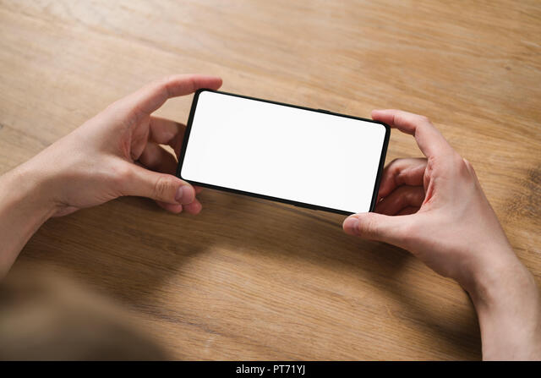
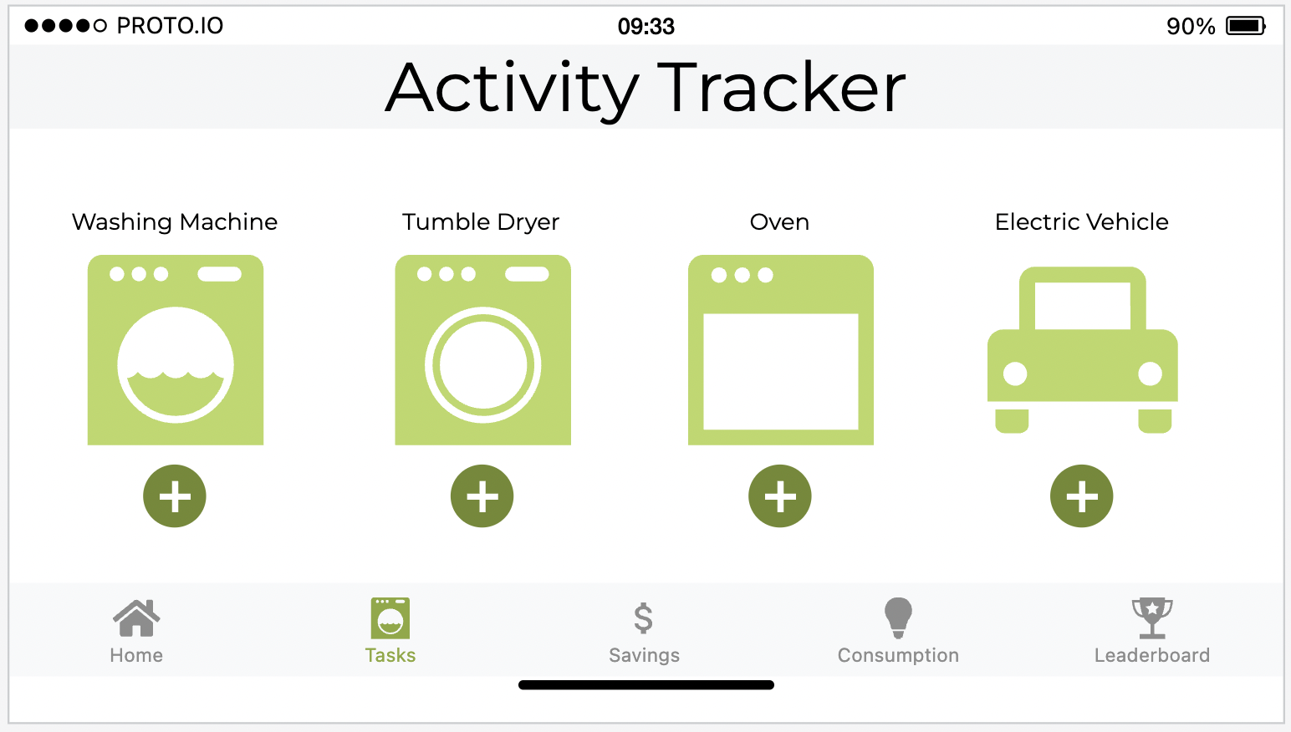
User journey
Dave owns a 3 bedroom home with his wife and 2 children.
As a household, they are wanting to reduce their carbon footprint and download the UseLess app to help them do so.
Since the pandemic, Dave has begun working from home a lot more and has realised their energy consumption has increased throughout the day.
Although the data is opensource and available widely online, Dave struggles to interpretate the vast amount of information and how to make it relevant for his household.
Dave is able to better utilise the visually represented data within the dashboard to make more environmentally friendly decisions around when to switch his appliances on.
Dave has also connected with his family and friends through the app via the leaderboard tab

Slide 6
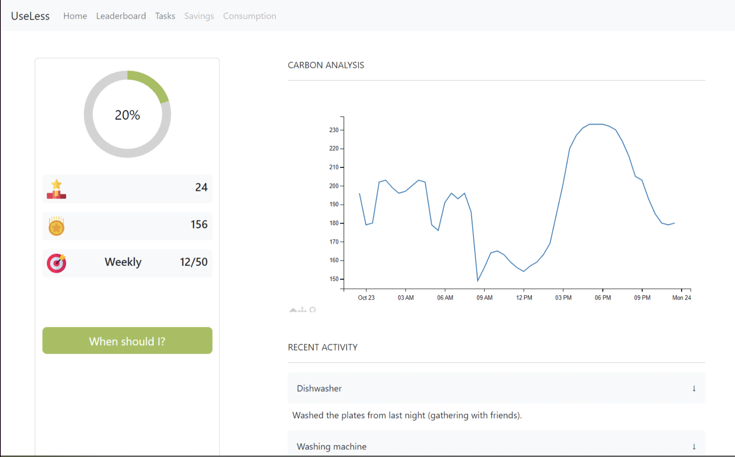
01
DASHBOARD
Features:
Graph showing carbon intensity for the coming 24hr period
Recent appliance activity, listed by appliance – expandable for more info
Visual representation on goal progress and points earned

Slide 7

02
TASKS
Features:
Appliance listing allowing selection to log activity using the + button
Prototype

Slide 8
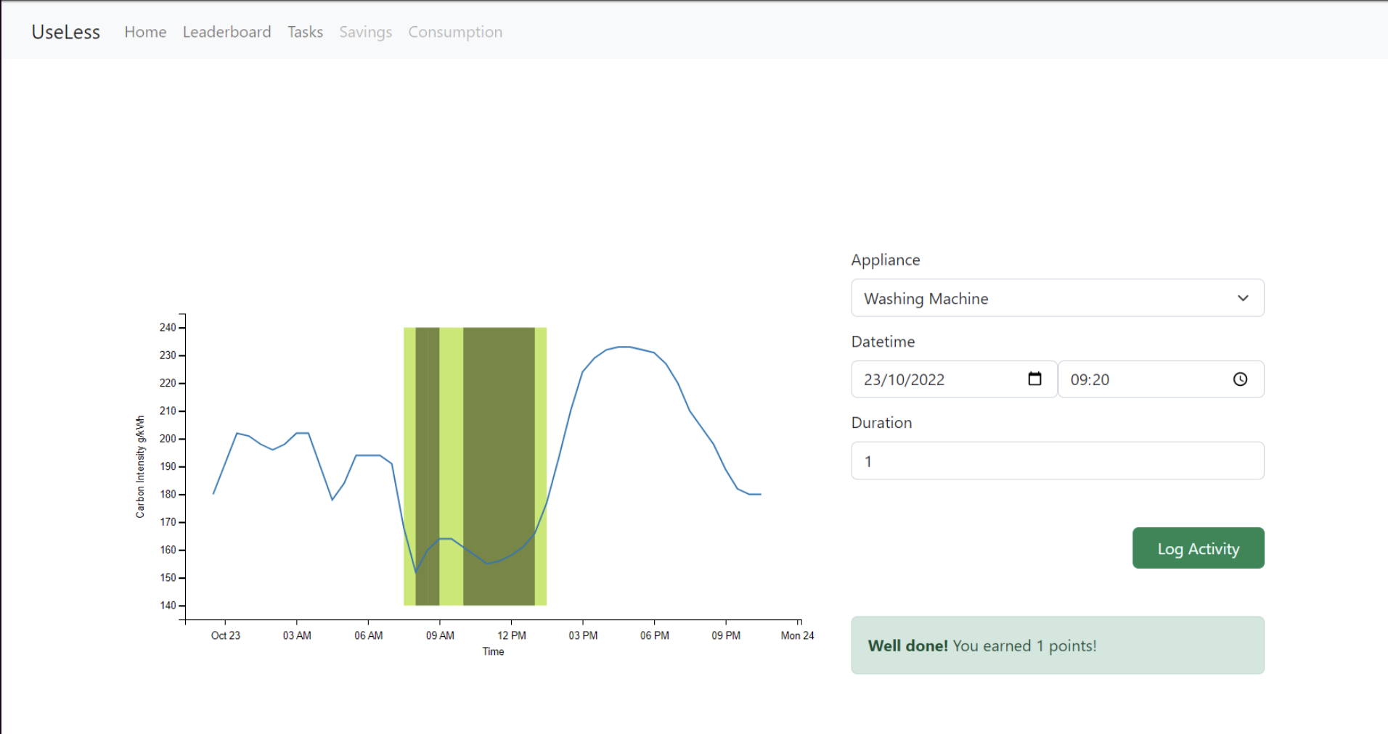
02
TASKS - ADD
Features:
Appliance specific screen allowing users to specify time and duration of users
Validation could be used to prevent erroneous timings
The recommendations are specific to the duration of the activity

Slide 9
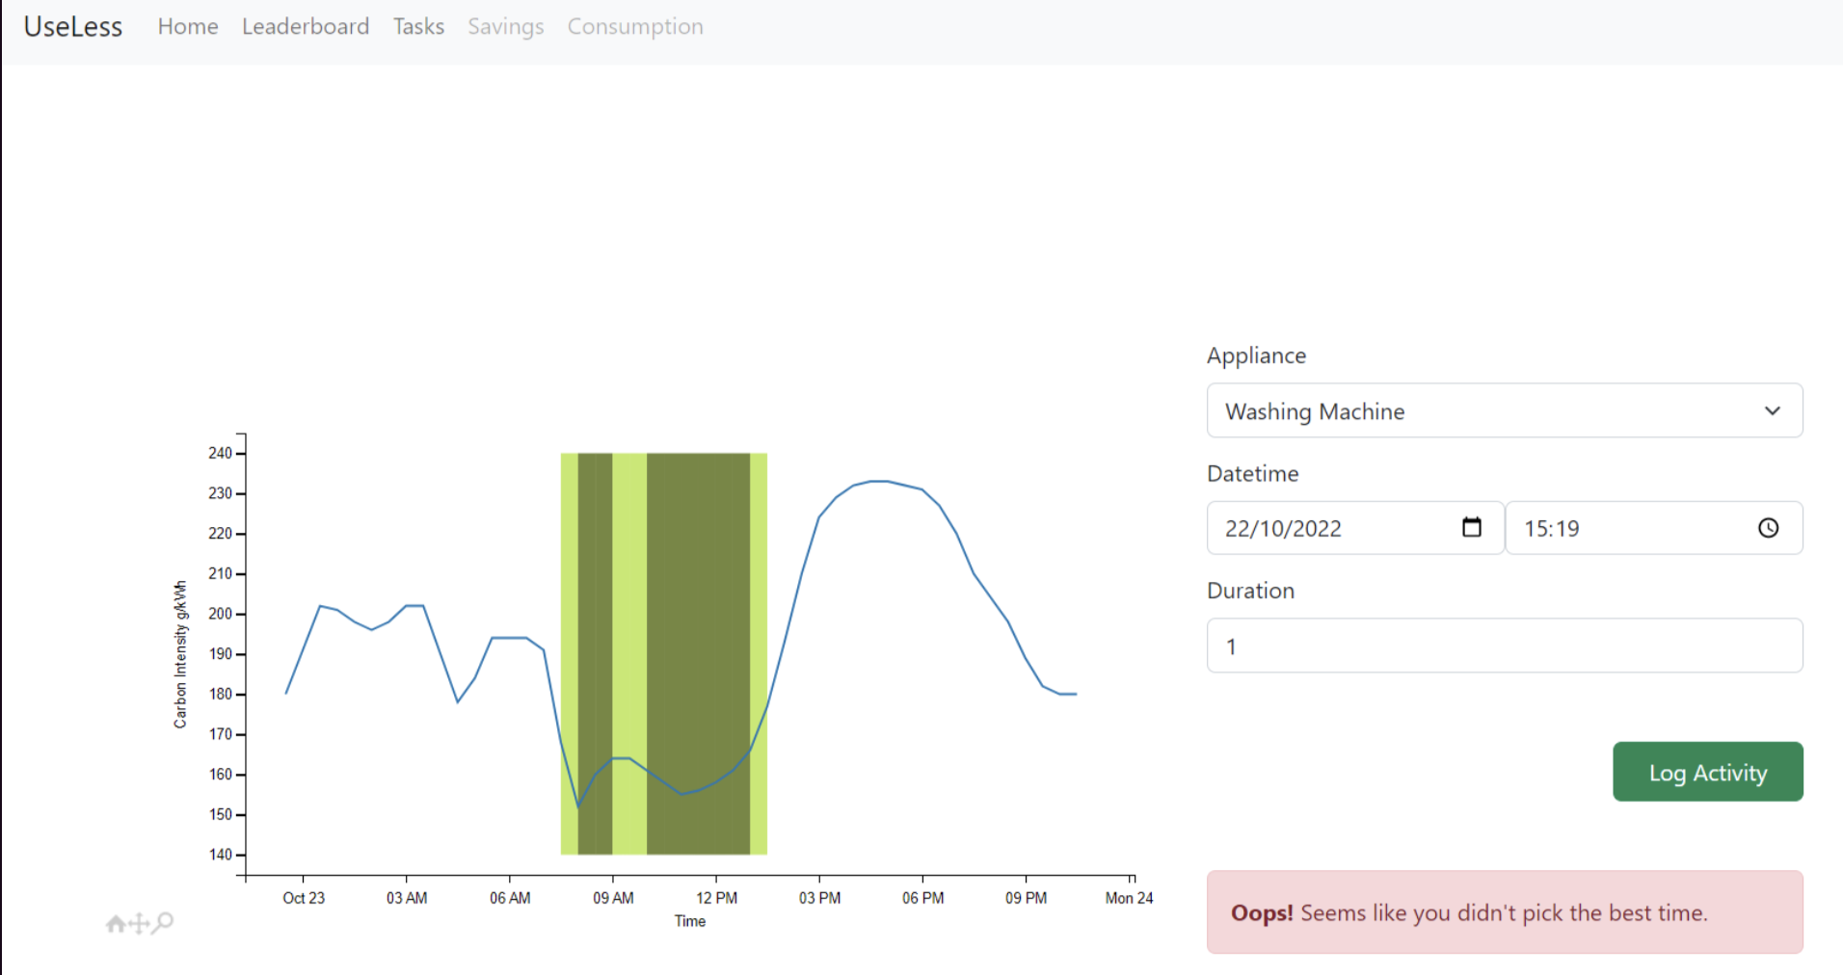
02
TASKS - ADD
Features:
Pop up alert notifying the user hasn’t completed the activity in the most efficient time slot.

Slide 10
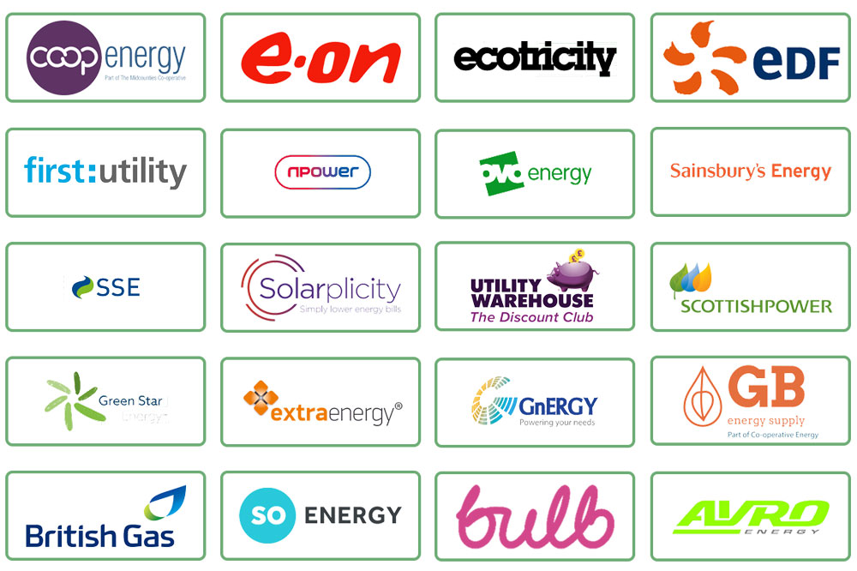
03
SAVINGS
Features:
Financial information available for those users on a variable rate who can save money when using energy at their suppliers lowest rates.
Future iterations could look to integrate with energy providers in order to compare rates and show users how to save money.

Slide 11
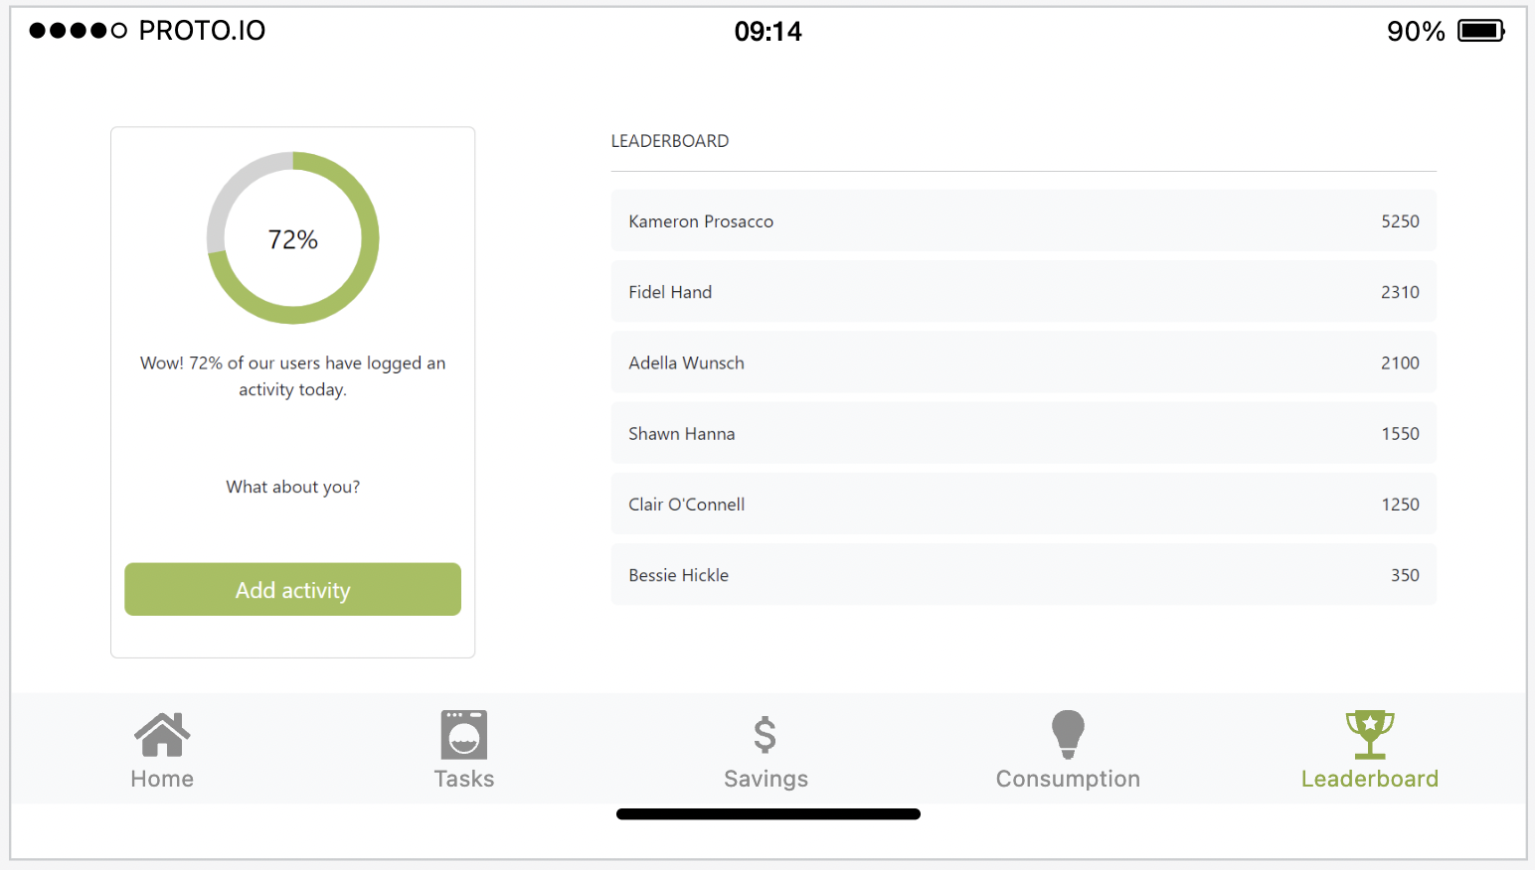
04
LEADERBOARD
Features:
Allowing users to compete against family and friends with a leader board, creating a natural competitive element whilst helping the environment.
The points system works by allocating points, on a 1, 2, 3 point basis, for using any appliance during recognised low carbon intensity periods. The tier system is recognised as the 3 lowest carbon intensive periods in the next 24-hour period, with 3 points for the lowest, and so forth.

Slide 12
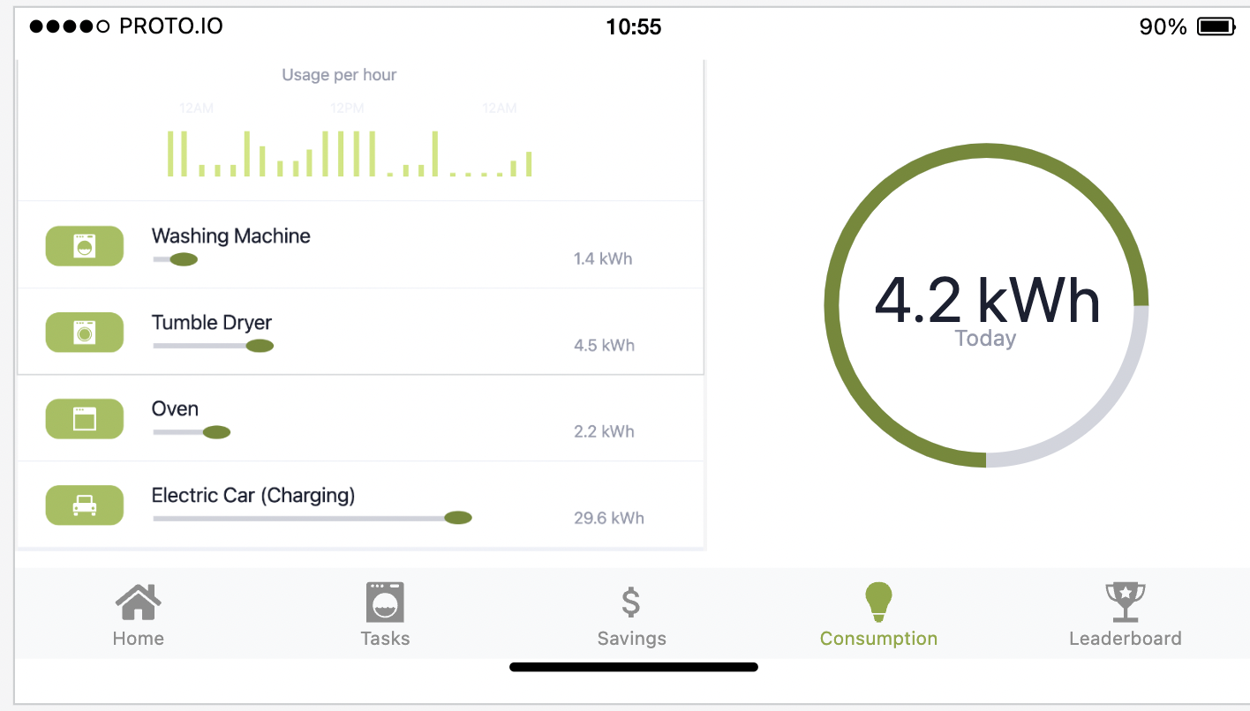
05
CONSUMPTION
Features:
A running history of the users appliance usage including date, time, kWh
A graphical usage chart for the previous 7 days
Prototype

Slide 13
FUTURE CONCEPTS
WEATHER API
PERSONALISATION
01
Weather and climate data to recommend energy efficient actions to app users e.g., wind intensity is optimal to hang the washing outside.
Personalizing the point system based on specific activity e.g., using a low intensity appliance during a recognised low carbon intensity period accrues higher points that using a low intensity appliance during a non-recognised period.
02
03
INCENTIVISATION
04
PARTNERSHIP
Converting the pointing system to rewards through the means of business partnership and sponsors
Partnering with energy providers to utilise specific tariff based data and financial incentives

